Slide 1
Compiler-Driven Data Layout Transformation for Heterogeneous Platforms
HeteroPar'2013
Deepak Majeti¹, Rajkishore Barik²
Jisheng Zhao¹, Max Grossman¹, Vivek Sarkar¹

Slide 2
Acknowledgments
I would like to thank the Habanero team at Rice University for their support.
I would also like to thank the reviewers for their valuable feedback.

Slide 3
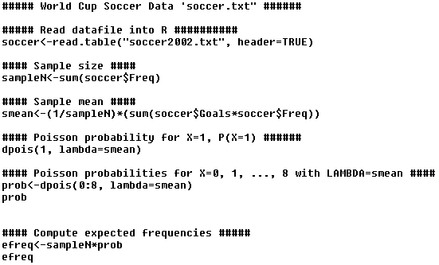
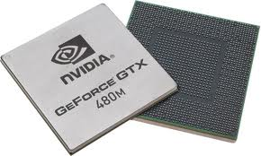
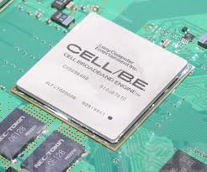
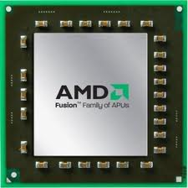
Introduction
Heterogeneity is ubiquitous – both in client as well and server domains
Portability and Performance

Slide 4
Motivation
How does one write portable and performant programs?
How do we port existing application to the newer hardware?
This is a hard problem.
Example: A CPU has different architectural features compared to a GPU.
Need high level language constructs,
efficient compiler and runtime frameworks

Slide 5
Motivation
Each processor has a different memory(cache) hierarchy
Each memory hierarchy demands a different data layout
CPU performs well with a struct layout because of prefetching
GPU performs well with an array layout because of coalescing
In our experiments, the layout impacted the performance of one application by a factor of 27.
Need to automatically map data structures

Slide 6
Prefetching on CPU
Load A[0]
Load B[0]
Load A[4]
Load B[4]
Load A[0]
Load B[0]
Load A[4]
Load B[4]
CPU 1
CPU 2
CPU 1
CPU 2
A0
B0
A4
B4
A0
B0
A4
B4
L1 cache
L1 cache
L1 cache
L1 cache
2 Loads/processor
1 Load/processor
A0
B0
A1
B1
A2
A0
A2
A3
A0
B0
A0
A1
A4
A4
B3
A4
B4
B0
B1
B2
B3
B4
B2
A3
A4
B4
B0
B4
Main Memory
Main Memory
Without Prefetching
With Prefetching

Slide 7
Coalescing on GPU
Load A[0-15]
Load B[0-15]
Load C[0-15]
Load A[16-31]
Load B[16-31]
Load C[16-31]
Load A[0-15]
Load B[0-15]
Load C[0-15]
Load A[16-31]
Load B[16-31]
Load C[16-31]
SM 1
SM 2
SM 1
SM 2
C[16-31]
A[16-31]
A[0-15]
B[16-31]
C[0-9]
B[0-15]
C[0-15]
A[11-15]
B[27-31]
A[0-10]
A[27-31]
B[0-10]
C[10-15]
A[16-26]
B[11-15]
C[26-31]
B[16-26]
C[16-25]
L1 cache
L1 cache
L1 cache
L1 cache
128-byte Load
3 64-byte Loads/SM
3 64-byte Loads,
3 128-byte Loads/SM
A[11-15]
C[0-9]
B[11-15]
C[10-15]
[ABC][0-15]
A[0-15]
A[16-31]
A[0-10]
A[0-15]
A[16-31]
B[0-10]
B[16-31]
[ABC][16-31]
B[0-15]
B[16-31]
A[16-26]
B[0-15]
A[27-31]
B[16-26]
B[27-31]
C[16-25]
C[26-31]
C[0-15]
C[16-31]
C[0-15]
C[16-31]
Coalesced Access
Non-Coalesced Access

Slide 8
Our Approach
Restrict data structures in programming model so that they can be implemented with different data layouts without changing the program semantics
We propose a compiler driven meta-data layout framework to abstract away the data layout from the program.
Auto-tuner / expert programmer specifies the metadata file.
A metadata file contains a high level view of the data layout.
Compiler auto-generates the program based on the metadata for the target architecture.

Slide 9
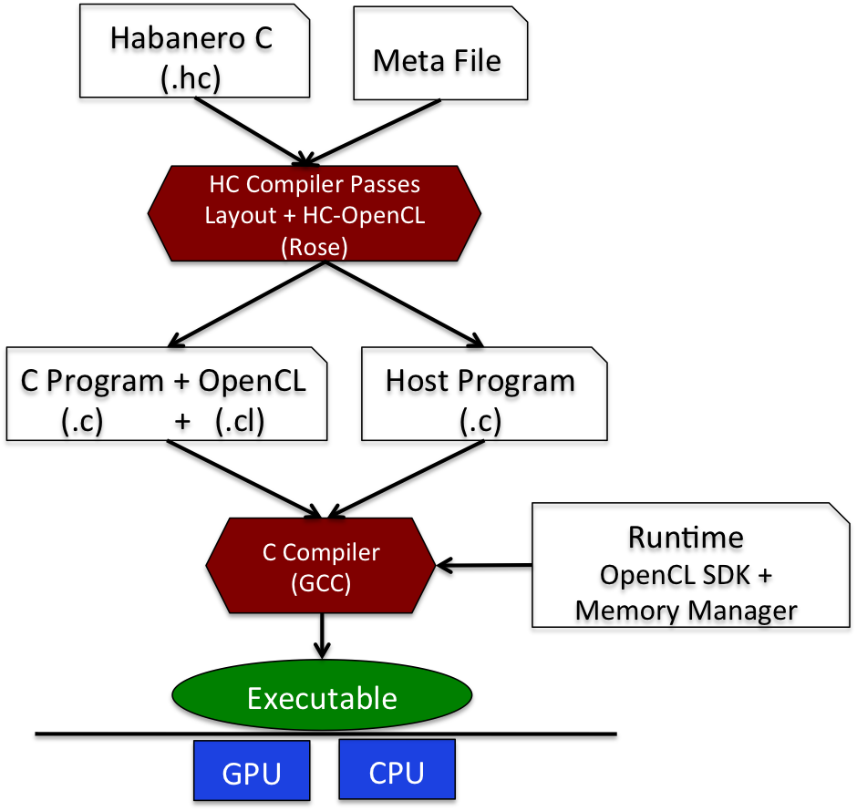
Overall Framework

Slide 10
Habanero-C forasync Multidimentional Parallel Loop Construct
forasync point (args) size (args) seq (args)
{
Body
}
Loop indices in each dimension are specified by the point clause.
The number of iterations in each dimension is specified by the size clause.
The tile size is specified by the seq clause
forasync is compiled to OpenCL (CPU and GPU).
forasync can also be compiled to Habanero-C runtime for CPUs only
Full details are available at https://wiki.rice.edu/confluence/display/HABANERO/Habanero-C

Slide 11
forasync to OpenCL kernel
int main(){
……………
forasync point(i, j) size(M, N) seq(tilesize1, tilesize2) {
a[i * M + j] = b[i * M + j] + c[ i * M + j];
}
…………….
}
void offload(float *a, float *b,
char *kernel_name, char* ocl_kernel)
{
//Build the kernel
//copy data from host to the device buffer
//execute the kernel
//copy data back from the device to host buffer
..........
}
int main(){
offload(a, b, c, ”kernel_1”, Kernel_string);
}
Kernel_string=“
void kernel_1(__global float *a, __global float *b, __global float *c, int M, int N) {
i = get_global_id(1);
j = get_global_id(0);
a[i * M + j] = b[i * M + j] + c[ i * M + j];
}
“;

Slide 12
Metadata layout framework Algorithm
Auto-tuner/ expert programmer specifies a layout schema
Create data structure definitions.
For every function definition whose formal parameters belong to the schema, replace with the corresponding data structure in the schema.
For every instruction, update the reference of such formal parameter with the new data structure reference.

Slide 13
Metadata Framework Example
int main(){
forasync point(i, j) size(M, N) seq(tilesizeq1, tilesize2) {
a[i * M + j] = b[i * M + j] + c[ i * M + j];
}
}
Arch Intel_CPU
Struct ABC
Field fp a
Field fp b
Field fp c
struct ABC{float a, float b, float c};
void offload(struct ABC *abc,
char *kernel_name, char* ocl_kernel)
{
//OpenCL Host Code
..........
}
int main(){
struct ABC *abc = …………
offload(abc, ”kernel_1”, Kernel_string);
}
Kernel_string=“
struct ABC{float a, float b, float c};
void kernel_1(__global struct ABC *abc, int M, int N)
{
i = get_global_id(1);
j = get_global_id(0);
abc[i * M + j].a = abc[i * M + j].b + abc[ i * M + j].c;
}
“;

Slide 14
Metadata Framework Example
int main(){
forasync point(i, j) size(M, N) seq(tilesize, tilesize) {
a[i * M + j] = b[i * M + j] + c[ i * M + j];
}
}
Arch AMD_CPU
Struct AB
Field fp a
Field fp b
struct AB{float a, float b};
void offload(struct AB *ab, float * c, char *kernel_name, char* ocl_kernel)
{
//OpenCL Host Code
..........
}
int main(){
struct AB *ab = …………
offload(ab, c, ”kernel_1”, Kernel_string);
}
Kernel_string=“
struct AB{float a, float b};
void kernel_1(__global struct AB *ab,
__global float *c, int M, int N) {
i = get_global_id(1);
j = get_global_id(0);
ab[i * M + j].a = ab[i * M + j].b + c[ i * M + j];
}
“;

Slide 15
Metadata layout framework Current Limitations
The transformation depends upon the names of the fields.
One can use a smart variable renaming scheme
Assumes a strongly typed program.
Pointer manipulations are hard to transform between layouts
Cannot handle pointer swaps between fields of different layout groups

Slide 16
Benchmarks
Name | Description | Original Layout | Num of Fields | Input
NBody | N-Body Simulation | SOA | 7 | 32K nodes
Medical Imaging | Image Registration | SOA | 6 | 256 x 256 x 256
SRAD | Speckle Reducing Anisotropic Diffusion | SOA | 4 | 5020 x 4580
Seismic | Seismic Wave Simulation | SOA | 6 | 4096 x 4096
MRIQ | Matrix Q Computation for 3D Magnetic Resonance Image Reconstruction in Non-Cartesian Space | SOA | 6 | 64 x 64 x 64

Slide 17
Experimental Setup
Vendor | Type | Model | Freq | Cores | L1$ | L2$
Intel | CPU | X5660 | 2.8 GHz | 12(HT) | 192 KB | 1.5 MB
Intel | Integrated GPU | I7-3770U | 1.15 GHz | 14 | N.A | N.A
NVIDIA | Discrete GPU | Tesla M2050 | 575 MHz | 8 | 128 KB | 768 KB
AMD | CPU | A10-5800K | 1.4GHz | 4(HT) | 192 KB | 4 MB
AMD | Integrated GPU | Radeon HD 7660 | 800MHz | 6 | N.A | N.A

Slide 18
Experimental Methodology
Timing
Minimum time over 5 runs
Normalized Time
Layouts are compared to the fastest layout implementation on each architecture.
Overheads
Data communication
OpenCL kernel creation/ launching
Layouts
AOS: Array of Structures
SOA: Structure of Arrays
AOS1: Intermediate Hybrid representation

Slide 19
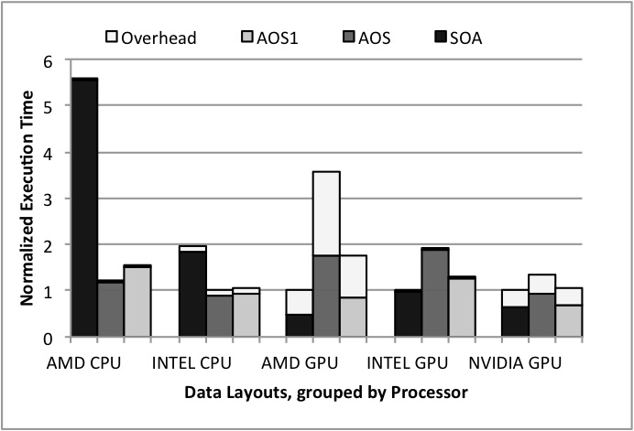
Experimental Results
Medical Imaging benchmark
Array of structures (AOS) is better for the CPUs.
Kernel benefits from spatial locality
Structure of arrays (SOA) is better for the GPUs.
Due to coalescing

Slide 20
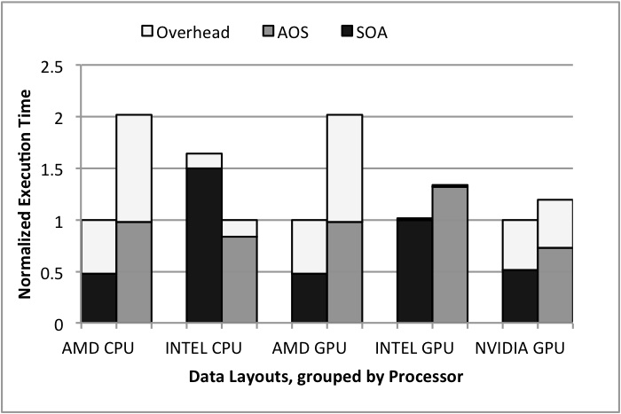
Experimental Results
Seismic benchmark
Array of structures(AOS) is better for the AMD CPU.
Possibly due to cache associativity on CPUs
Structure of arrays(SOA) is better for the INTEL CPU and GPUs.
Coalescing for GPUs

Slide 21
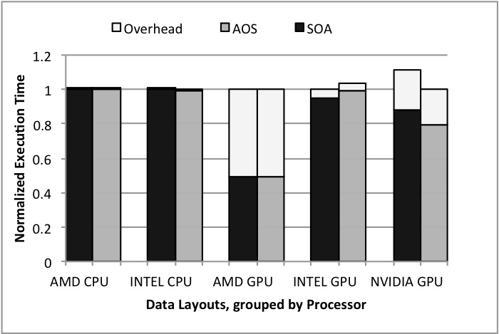
Experimental Results
MRIQ benchmark
Data layout play no role in performance on CPUs and GPUs.
Kernel is compute bound.

Slide 22
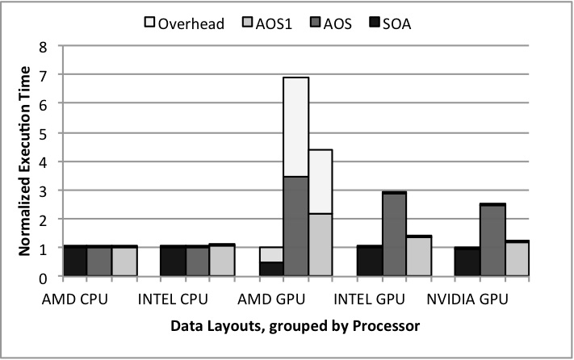
Experimental Results
NBody benchmark
AOS better for GPUs.
Coalescing
Data layout plays no role in performance on CPUs.
No gain from spatial locality.

Slide 23
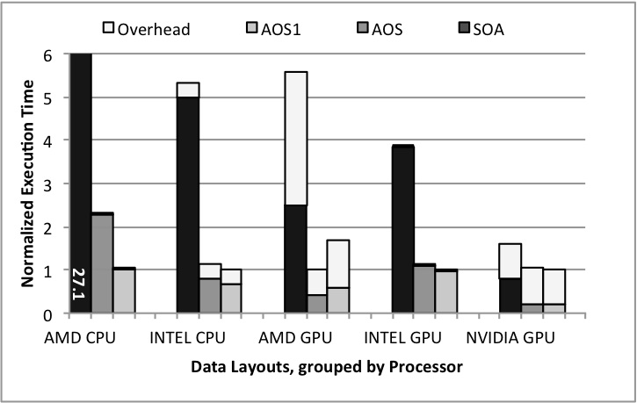
Experimental Results
SRAD benchmark
Array of Structures (AOS) is best on AMD GPU.
Intermediate Array of Structures (AOS1) is best on all the other platforms.
The non-affine accesses in the kernel make it hard to predict the correct layout.

Slide 24
Conclusion
Different architectures require different data layouts to reduce communication latency. The meta-data layout framework helps bridge this gap.
We extend Habanero-C to support a meta-data layout framework.
Auto-tuner / expert programmer specifies the metadata file.
Compiler auto-generates the program based on the meta data for the target architecture.
The meta-data framework also helps take advantage of the various scratchpad memory available on a given hardware.
Notes:
by automatically generating the program for a specified layout.

Slide 25
Future Work
Come up with auto-tuning frameworks and heuristics to automatically determine the layouts on a specific hardware.

Slide 26
Related Work
Data Layout Transformation Exploiting Memory-Level Parallelism in Structured Grid Many-Core Applications. Sung et.al., PACT 10
Change indexing for memory level parallelism
DL: A data layout transformation system for heterogeneous computing. Sung et.al., InPar’12.
Change the data layout at runtime
Dymaxion: optimizing memory access patterns for heterogeneous systems, Che et al., SC ’11
runtime iteration space re-ordering functions for better memory coalescing
TALC: A Simple C Language Extension For Improved Performance and Code Maintainability. Keasler et.al., Proceedings of the the 9th LCI International Conference on High-Performance Clustered Computing
Only for CPUs and focus on meshes

Slide 27
Thank you

