Slide 1
An approach for solving the Helmholtz Equation
on heterogeneous platforms
G. Ortega¹, I. García² and E. M. Garzón¹
¹Dpt. Computer Architecture and Electronics. University of Almería
²Dpt. Computer Architecture. University of Málaga

Slide 2
Outline
Introduction
Algorithm
Multi-GPU approach Implementation
Performance Evaluation
Conclusions and Future works
Notes:
First of all, we find the outiline with the main points to deal in this presentation:
We are going to start with a brief introduction about the Optical Difracction Tomography.
Afterthat, the model background in which the ODT approach is based on is described in detail.
The third section is devoted to analysing the model and a study of the computational memory requirements is carried out. Moreover, in this section, our approaches to parallelize the most computationally expensive parts of the algorithm are described.
Section 4 illustrates the obtained results for several examples of ODT problems.
Section 5, evaluates our implementation over different HPC platforms(multicore and MultiGPU computing).
Finally, Section 6 summarizes the main conclusions and lines of future works.

Slide 3
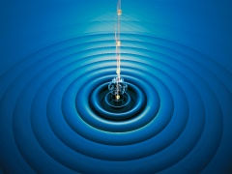
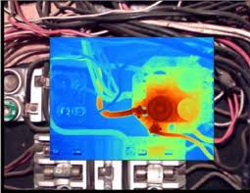
Introduction
Motivation
The resolution of the 3D Helmholtz equation → Development of models related to a wide range of scientific and technological applications:
Mechanical
Acoustical
Thermal
Electromagnetic waves
Notes:
Nowadays, the society is interested in the study of cardio vascular diseases, as they are one of the main causes of death in developed countries. One of the most important vascular diseases is the formation of brain aneurysms that is an abnormal dilation of one of the arteries in the brain.
Due to the fact that biological flows (e. g. an aneurysm flow) are clearly three-dimensional, some threedimensional (3C-3D)
measurements will be needed in order to solve the problem of the reconstruction of the vessel wall of the flow.
Holographic Particle Image Velocimetry (HPIV) provides a non-damage method for
three-dimensional, three-component flow measurements using holographic recordings of seeding particles in a fluid. However, it still is a challenge
to measure biofluidic flows with enough spatial resolution.
Optical Difracction Tomography has been recently introduced in fluid velocimetry to provide threedimensional information of the location of particles. In particular, author’s previous works have proven the potential of Optical Diffraction Tomography for biological and microfluidic devices. First Born Approximation has been used for three
dimensional image reconstruction, but a non-linear reconstruction method is required
when multiple scattering is not negligible. Therefore a non-linear iterative optimization
technique has been used to locate the seeding particles and compute afterward the flow
velocity field. This inversion method requires the solution of the Helmholtz equation
twice in each iteration, that computationally is highly demanding. Therefore, High
Performance Computing (HPC) is required to find the particle locations. This work
shows the results of accelerating this task using GPU computing and a storing format made-to-measure.

Slide 4
Introduction
Helmholtz Equation
Literature:
Other authors → Don’t use heterogeneous multi-GPU clusters.
Linear Eliptic Partial Differential of
Equations (PDE).
$$(∇^{2}\left(r\right)+{k(r)}^{2}) E\left(r\right)=0$$
Green’s Functions
Spatial Discretization (based on FEM)
Large linear system of equations
A is sparse, symmetric and with a
regular pattern
$$Ax=b$$
Notes:
Our model relies on the Helmholtz Equation. This is because according to the scalar diffracion

Slide 5
Introduction
Goal
Develop a parallel solution for the 3D Helmholtz equation on a heterogeneous architecture of modern multi-GPU clusters
Extend the resolution of problems of
practical interest to several
different fields of Physics.
OUR PROPOSAL→ mem. req.
and runtime reductions
BCG method
(1) multi-GPU clusters (2) Regular Format matrices (3) Acceleration SpMVs & vector
operations
Notes:
The numerical solution of this Partial Differential Equation (PDE) is based on the spatial discretization of differential operators → a linear system of equations (Mx = b) in C has to be solved.

Slide 6
Outline
Introduction
Algorithm
Regular Format
Multi-GPU approach Implementation
Performance Evaluation
Conclusions and Future works
Notes:
First of all, we find the outiline with the main points to deal in this presentation:
We are going to start with a brief introduction about the Optical Difracction Tomography.
Afterthat, the model background in which the ODT approach is based on is described in detail.
The third section is devoted to analysing the model and a study of the computational memory requirements is carried out. Moreover, in this section, our approaches to parallelize the most computationally expensive parts of the algorithm are described.
Section 4 illustrates the obtained results for several examples of ODT problems.
Section 5, evaluates our implementation over different HPC platforms(multicore and MultiGPU computing).
Finally, Section 6 summarizes the main conclusions and lines of future works.

Slide 7
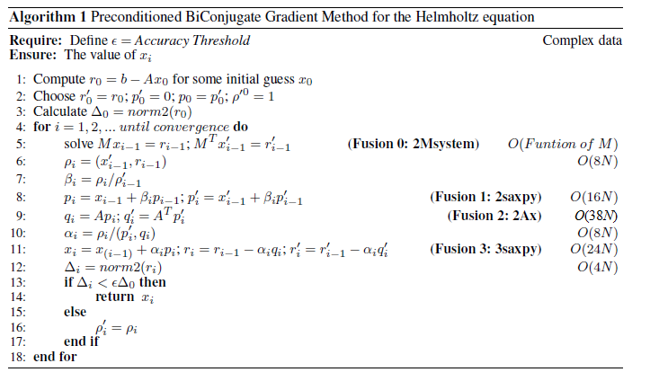
Algorithm
Biconjugate Gradient Method
$$Ax=b$$
dots
saxpy
SpMV
Regular Format

Slide 8
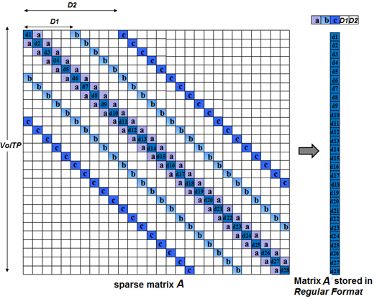
Algorithm
Regular Format
Complex symmetric matrix
Max seven nonzeros/row
Nonzeros are located by seven diagonals
Same values for lateral diagonals (a, b, c)
Regularities
Mem. Req. (GB) for storing A:
VolTP CRS ELLR-T Reg Format
160³ 0.55 0.44 0.06
640³ 35.14 28.33 3.91
1600³ 549.22 442.57 61.04
The arithmetic intensity of SpMV based on Regular Format is 1.6 times greater than this parameter for the CRS format if a = b = c = 1
Notes:
a specific storage format, which stores the minimal information to define the sparse matrix, is considered. In this way, both, memory requirements and BCG runtime are considerably reduced since this new format requires less memory accesses to read sparse matrix elements. Hereinafter the format which takes advantage of the regularities of M is referred to as Regular Format.
So, the Regular Format (Figure 2) consists of storing: (1) a complex array (M[]) of V olTP dimension, (2) three integer
values (a, b and c) for storing the lateral diagonals values, and (3) two additional integer values D1, D2 which point at the location of the first row lateral diagonals. In terms of memory requirements, Table IV shows the considerable reduction of memory requirements of the Regular
Format with respect to general formats for storing sparse matrices on multicore processors (CRS) or on GPUs (ELLRT).
Reduces los accesos a memoria y las operaciones en punto flotante.

Slide 9
Outline
Introduction
Algorithm
Multi-GPU approach Implementation
Performance Evaluation
Conclusions and Future works

Slide 10
Multi-GPU approach implementation
Implementation on Heterogeneous platforms
Exploiting the heterogeneous platforms of a cluster has two main advantages:
Larger problems can be solved because the code can be distributed among the available nodes;
Runtime is reduced since more operations are executed at the same time in different nodes and accelerated by the GPU devices.
To distribute the load between CPUs and GPU processes:
MPI to communicate multicores in different nodes.
GPU implementation (CUDA interface)

Slide 11
Multi-GPU approach implementation
MPI implementation
One MPI process per CPU core or GPU device is started.
The parallelization of the sequential code has been done according to the data parallel concept.
Sparse matrix →The row-wise matrix decomposition.
Important issue → Communications among processors occur twice at every iteration:
Dot operations. (MPI_Allreduce) (synchronization point)
Two SpMV operations → regularity of the matrix → swapping halos
Notes:
Un slice del vol que corta con la posicion de algunas particulas.

Slide 12
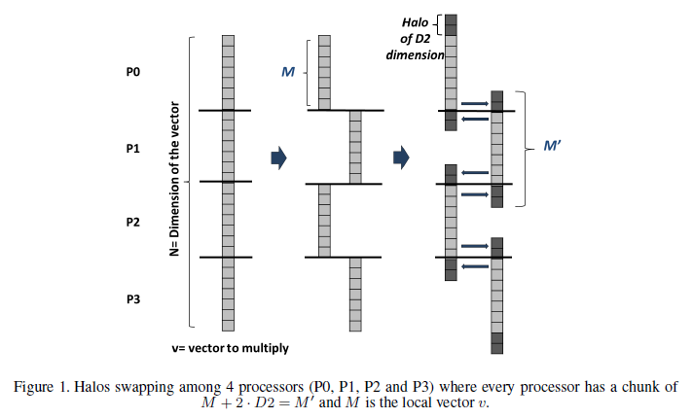
Multi-GPU approach implementation
Halos swapping
It is advantageous only when the percentage of redundancy with respect to the total data of every process is small; i.e. when P ≪ N/D2, where P is the number of MPI tasks, N the dimension of A and D2 half of the halo elements.
Notes:
Un slice del vol que corta con la posicion de algunas particulas.

Slide 13
Multi-GPU approach implementation
GPU Implementation
The exploitation of one GPU device per processor.
All the operations are carried out in the GPUs but when a communication process is required among cluster processors, data chunks are copied to the CPU and the exchange among processors is executed.
Each GPU device is devoted to computing all the local vector operations (dot, saxpy) and local SpMVs which are involved in the BCG specifically suited for solving the 3D Helmholtz equation.
Optimization techniques:
The reading of the sparse matrix and data involved in vector operations are coalesced global memory access, this way the bandwidth of global memory is maximized.
Shared memory and registers are used to store any intermediate data of the operations which constitute Fast-Helmholtz, despite the low reuse of data in these operations.
Fusion of operations into one kernel.
Notes:
These optimizations are very relevant to improve the performance of operations dominated by memory
accesses (memory bounded) such as SpMVs, dots and saxpys which are the keys in Fast-Helmholtz.

Slide 14
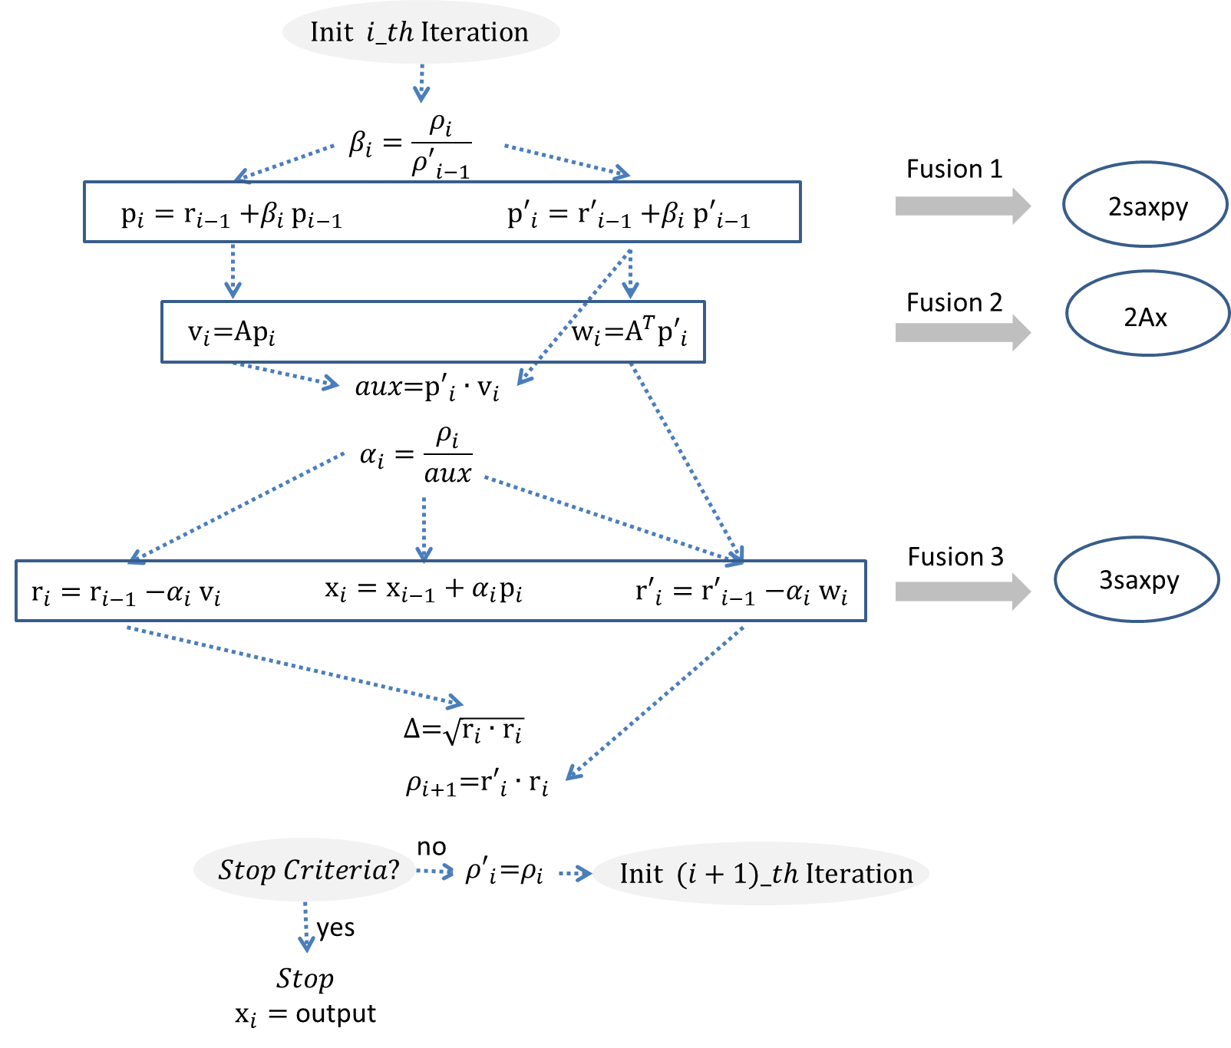
Multi-GPU approach implementation
Fusion of kernels
2 SpMVs can be executed at the same
time so avoiding the reading of A
twice → arithmetic intensity is
improved by this fusion.
Notes:
These optimizations are very relevant to improve the performance of operations dominated by memory
accesses (memory bounded) such as SpMVs, dots and saxpys which are the keys in Fast-Helmholtz.
Fusion of kernels:
Data dependencies are identified in the BCG algorithm;
The operations are reordered for joining all the operations that can be executed at the same time and
Fusions of independent operations are carried out and the corresponding kernels developed.
A specific kernel to compute the two SpMV operations (q = Ap and q′ = Ap′) on the GPU
platforms has been developed. In this kernel, every thread computes one element of the output vectors (q and q′). So, the loop to compute every row has been unrolled. In this way, the parallelism of this kernel is very high. In the kernel, the number of reads has been considerably reduced since the sparse matrix A is stored in the memory of the GPU for both SpMVs. Moreover, this optimization is combined with the advantages, in terms of performance, introduced by the use of our Regular Format.

Slide 15
Outline
Introduction
Algorithm
Multi-GPU approach Implementation
Performance Evaluation
Conclusions and Future works
Notes:
First of all, we find the outiline with the main points to deal in this presentation:
We are going to start with a brief introduction about the Optical Difracction Tomography.
Afterthat, the model background in which the ODT approach is based on is described in detail.
The third section is devoted to analysing the model and a study of the computational memory requirements is carried out. Moreover, in this section, our approaches to parallelize the most computationally expensive parts of the algorithm are described.
Section 4 illustrates the obtained results for several examples of ODT problems.
Section 5, evaluates our implementation over different HPC platforms(multicore and MultiGPU computing).
Finally, Section 6 summarizes the main conclusions and lines of future works.

Slide 16
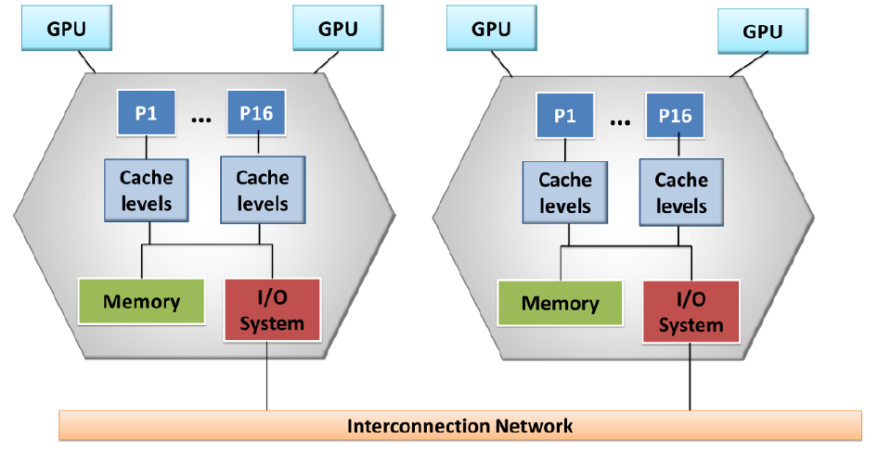
Performance Evaluation
Platforms
2 compute nodes (Bullx R424-E3. Intel Xeon E5 2650 (16 multicores) and 64 GB RAM).
4 GPUs, 2 per node. Tesla M2075: 5.24 GB memory resources per GPU. CUDA interface.

Slide 17
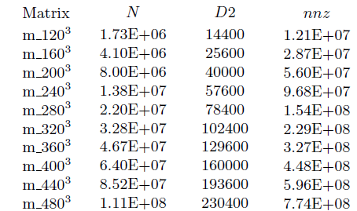
Performance Evaluation
Test matrices and approaches
Three strategies for solving the 3D Helmholtz equation have been proposed:
MPI
GPU
Heterogeneous: GPU-MPI

Slide 18
Performance Evaluation
Results (I)
Table: Runtime 1000 iterations BCG based on Helmholtz equation using 1 CPU core.
 | Seq (s)
m_120³ | 88.52
m_160³ | 235.75
m_200³ | 415.78
m_240³ | 791.31
m_280³ | 1142.22
m_320³ | 1915.98
m_360³ | 2439.45
m_400³ | 3752.21
m_440³ | 4536.67
m_480³ | 6522.29
OPTIMIZED code:
fusion, Regular Format, etc.
It takes 1.8 hours

Slide 19
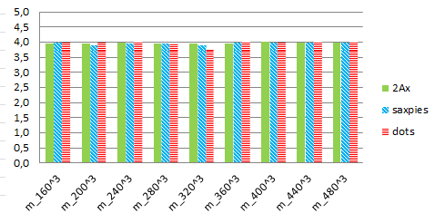
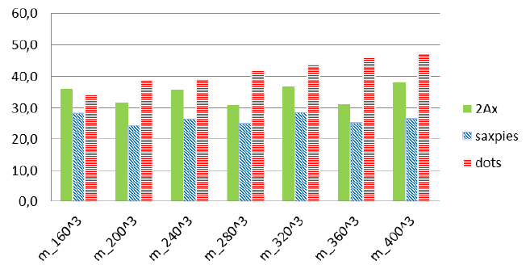
Performance Evaluation
Results (II)
Acceleration factors of operations
of 2Ax, saxpies and dots routines with 4 MPI processes
Acceleration factors of operations
of 2Ax, saxpies and dots routines with 4multi-GPUs

Slide 20
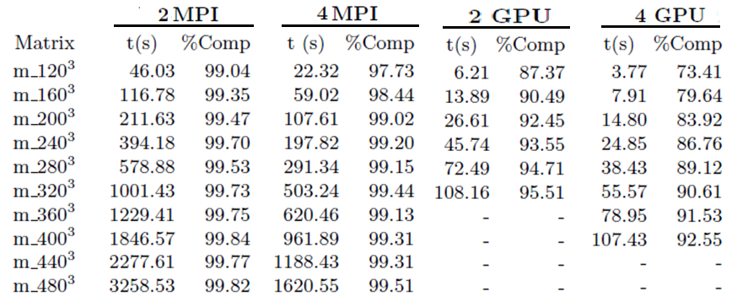
Performance Evaluation
Results(III)
Table: Resolution time (seconds) of 1000 iterations of the BCG based on Helmholtz, using 2
and 4 MPI processes and 2 and 4 GPU devices.
Acceleration Factor ≈ 9x

Slide 21
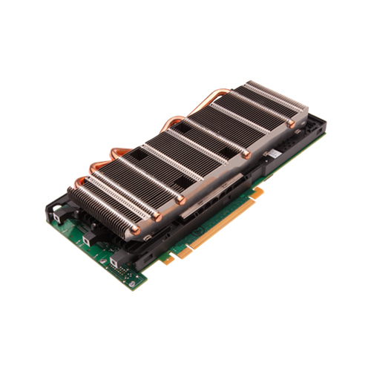
Performance Evaluation
Static Distribution of the load
Static workload balance scheduling has been considered →
The application workload is known at compile time and it fixed during the
execution. So, the distribution between the different processes can be done
at compile time.
Heterogeneous data partition = t. CPU/ t. GPU ≈ 10
CPU: Load GPU: 10*Load

Slide 22
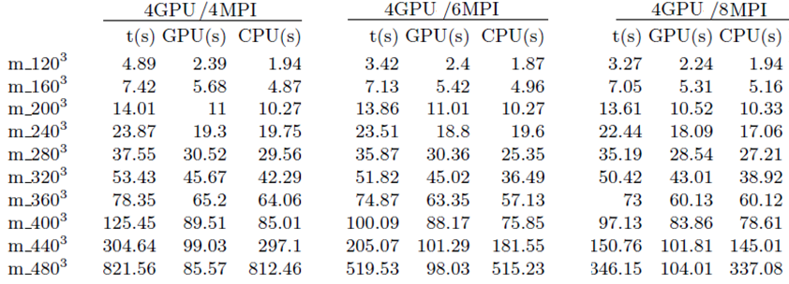
Performance Evaluation
Results (IV)
Table: Profiling of the resolution of 1000 iterations of the BCG based on Helmholtz using our
Heterogeneous approach with three diferent configurations of MPI and GPU processes.
Memory of the GPU is the limiting factor

Slide 23
Performance Evaluation
Results (V)
Runtime executions (s) of 1000 iterations of the BCG based on Helmholtz using our
Heterogeneous approach (4GPUs + 8 MPIs) and 4 GPU processes.
Improvement $≈10\%$
Runtime (s)
Notes:
First of all, we find the outiline with the main points to deal in this presentation:
We are going to start with a brief introduction about the Optical Difracction Tomography.
Afterthat, the model background in which the ODT approach is based on is described in detail.
The third section is devoted to analysing the model and a study of the computational memory requirements is carried out. Moreover, in this section, our approaches to parallelize the most computationally expensive parts of the algorithm are described.
Section 4 illustrates the obtained results for several examples of ODT problems.
Section 5, evaluates our implementation over different HPC platforms(multicore and MultiGPU computing).
Finally, Section 6 summarizes the main conclusions and lines of future works.

Slide 24
Outline
Introduction
Algorithm
Multi-GPU approach Implementation
Performance Evaluation
Conclusions and Future works
Notes:
First of all, we find the outiline with the main points to deal in this presentation:
We are going to start with a brief introduction about the Optical Difracction Tomography.
Afterthat, the model background in which the ODT approach is based on is described in detail.
The third section is devoted to analysing the model and a study of the computational memory requirements is carried out. Moreover, in this section, our approaches to parallelize the most computationally expensive parts of the algorithm are described.
Section 4 illustrates the obtained results for several examples of ODT problems.
Section 5, evaluates our implementation over different HPC platforms(multicore and MultiGPU computing).
Finally, Section 6 summarizes the main conclusions and lines of future works.

Slide 25
Conclusions and Future Works
Conclusions
The parallel solution for the 3D Helmholtz equation which combines the exploitation of the high regularity of the matrices involved in the numerical methods and the massive parallelism supplied by heterogeneous architecture of modern multi-GPU cluster.
Experimental results have shown that our heterogeneous approach outperforms the MPI and the GPU approaches when several CPU cores are used to collaborate with the GPU devices.
This strategy allows to extend end the resolution of problems of practical interest to several different fields of Physics.

Slide 26
Conclusions and Future Works
Future works
(1) to design a model to determine the most suitable factor to have the workload well-balanced;
(2) to integrate this framework in a real application based on Optical Diffraction Tomography (ODT)
(3) to include Pthreads or OpenMP for shared memory .
Notes:
Hemos mejorado el rendimiento pero el otro factor limitante es la memoria, de ahi que estemos viendo las implementaciones distribuidas.

Slide 27
Thank you for your attention

Slide 28
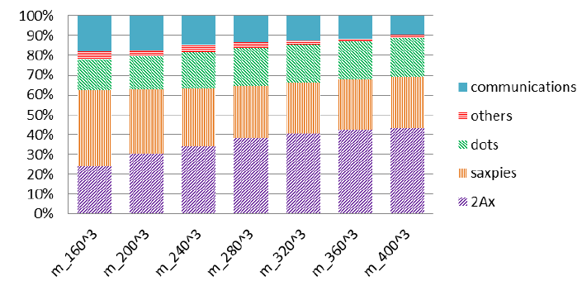
Performance Evaluation
Results (II)
Percentage of the runtime for each call to function using 4multi-GPUs

